Slide 1
MER311: Advanced Strength of Materials
LECTURE OUTLINE
Course Overview
Stress-Strain Relations

Slide 2
Course Website
http://rbb.union.edu/courses/mer311
http://me.union.edu
http://www.union.edu

Slide 3
Advanced Mechanics Topics
Elasticity
Isotropic
Anisotripic
Plates & Shells
Plasticity
Composite Mtl’s
Finite Element
Fracture
Adv Dynamics
Lagrangian
Mechatronics
Design
Optimization

Slide 4
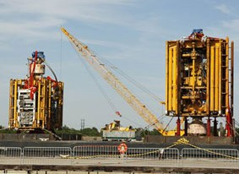
What are these and why did they capture the attention of our country and the world for almost three months in 2010?

Slide 5
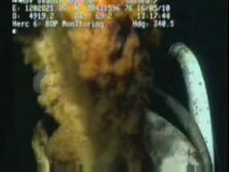
A close up of what happened when they failed. Do you know what they are now?

Slide 6
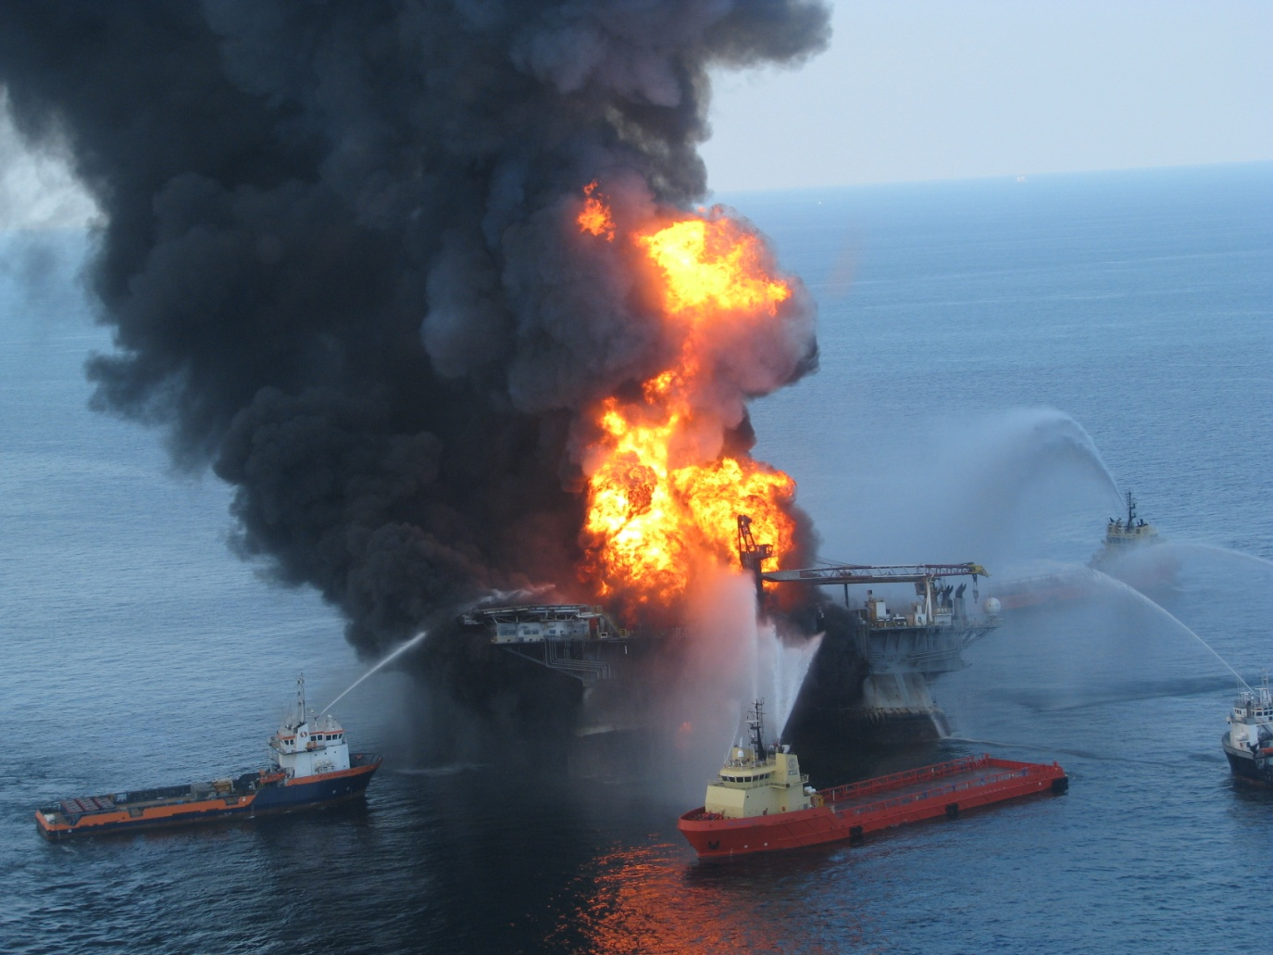
Five thousand feet above the failure, do you know what these are now?

Slide 7
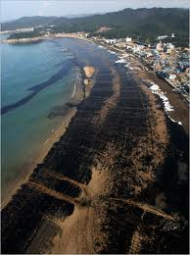

Who do you think is responsible?

Slide 8
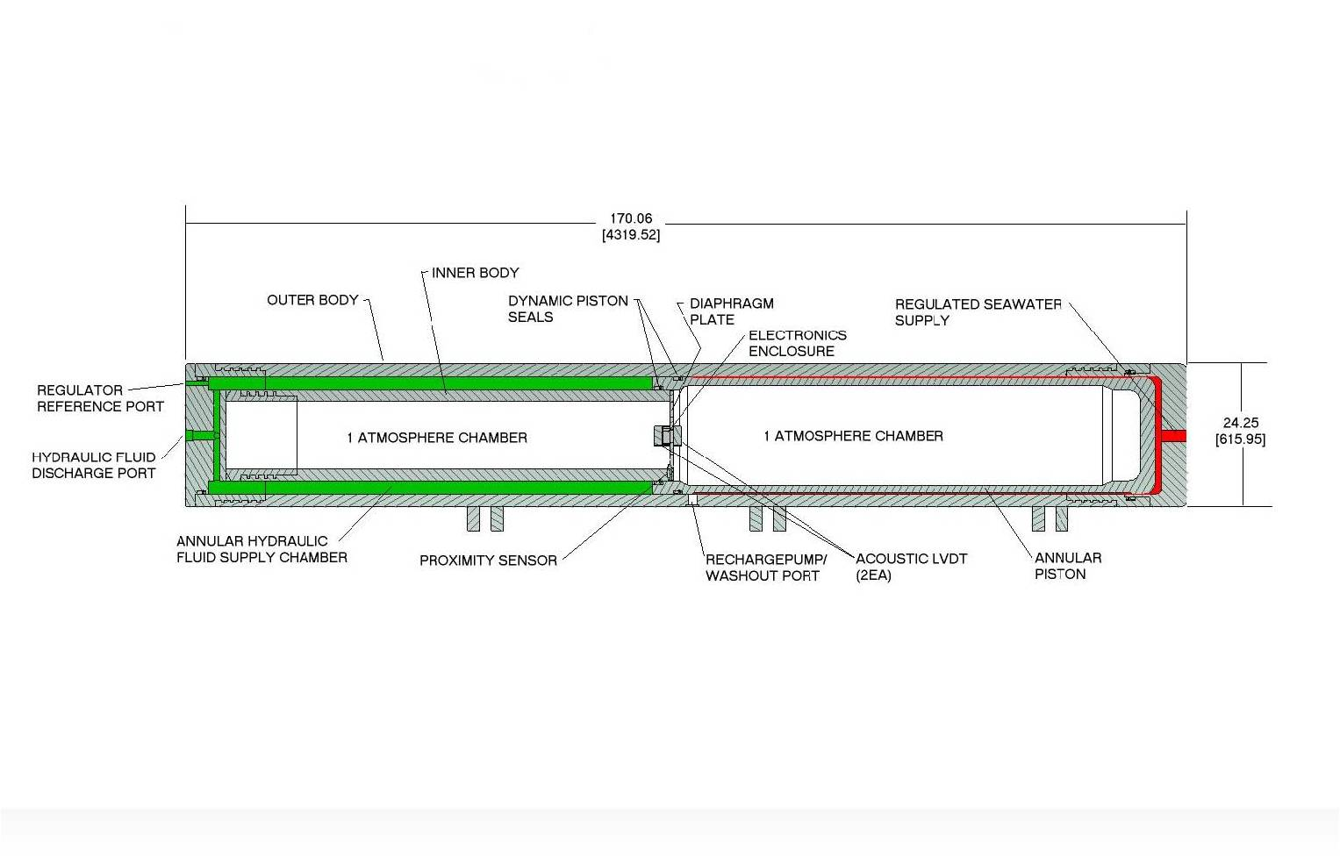
The Redesign

Slide 9
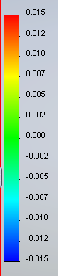

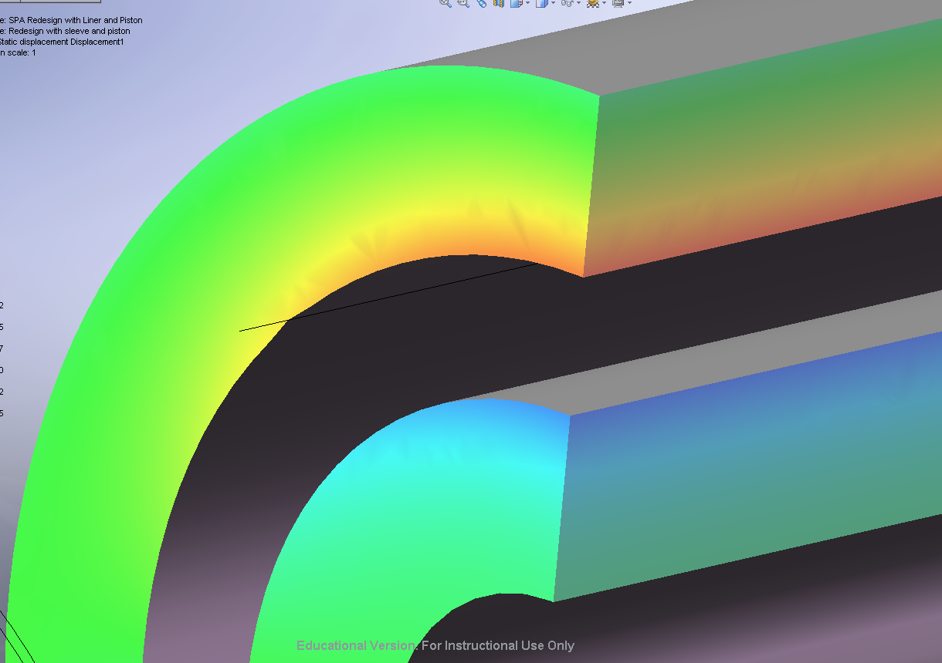
δy (Radial)
In The Inner and Outer Barrel
Without Sleeve
With Sleeve

Slide 10
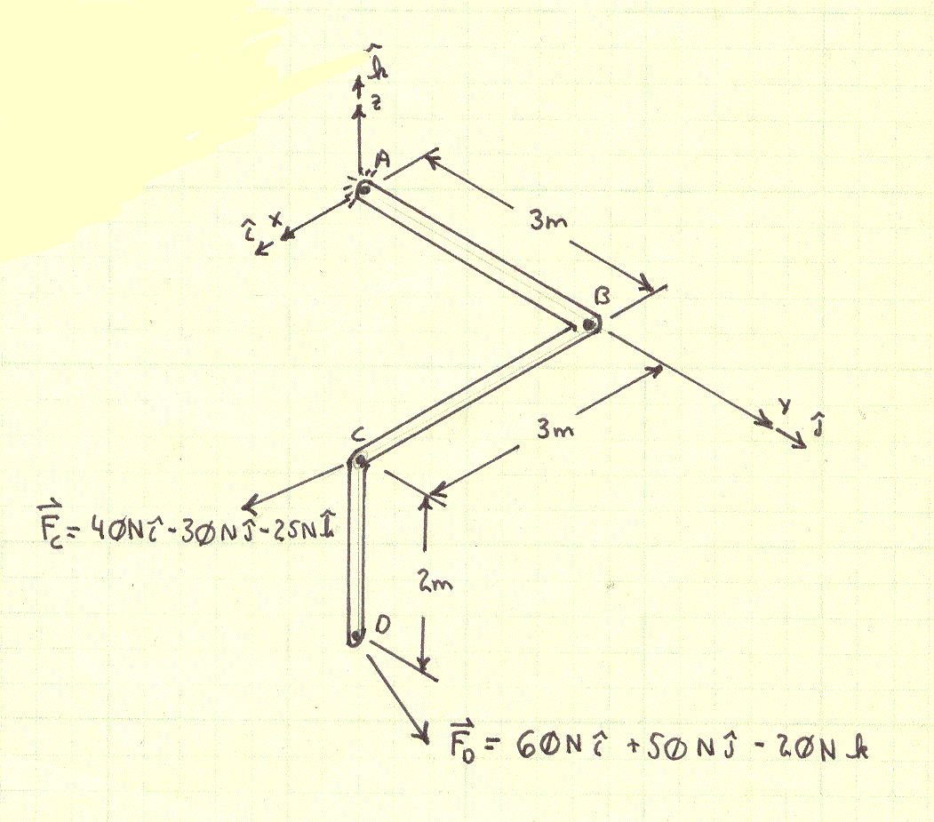
Example
For the structure and loading shown, determine the maximum stress in the structure.

